Slide 1
MA679
Physical Therapy Project
Group Members:
William Zen
Zara Waheed
Pruthvi Bharadwaj

Slide 2
Overview
Background
Data Description
Models we tried:
Functional Principal Component Analysis
Multivariate Functional Principal Component Analysis
AutoEncoder
Variational AutoEncoder
Comparisons between models

Slide 3
Background
Research Project | Predict MRI Osteoarthritis Knee Score (MOAKS)
A subproblem | Functional data (p=100) High dimensionality
What’s been tried | Manually extracted features from force patterns
Our Objective | Explore ML based dimensionality reduction techniques

Slide 4
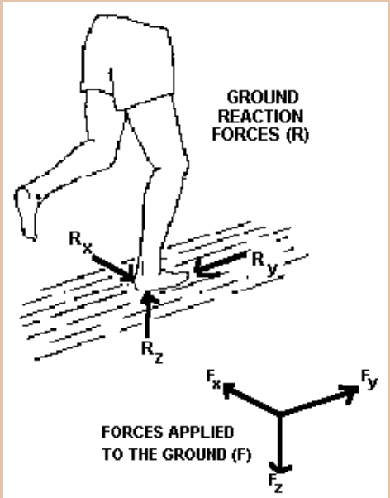
Data Description and Summary Statistics
Total participants = 2291
On average 5 trials per participant
Variables that we have:
3 components of GRF
2 components of COP
3 components of Moment
KNEE | #Trials
LEFT | 7862
RIGHT | 7834

Slide 5
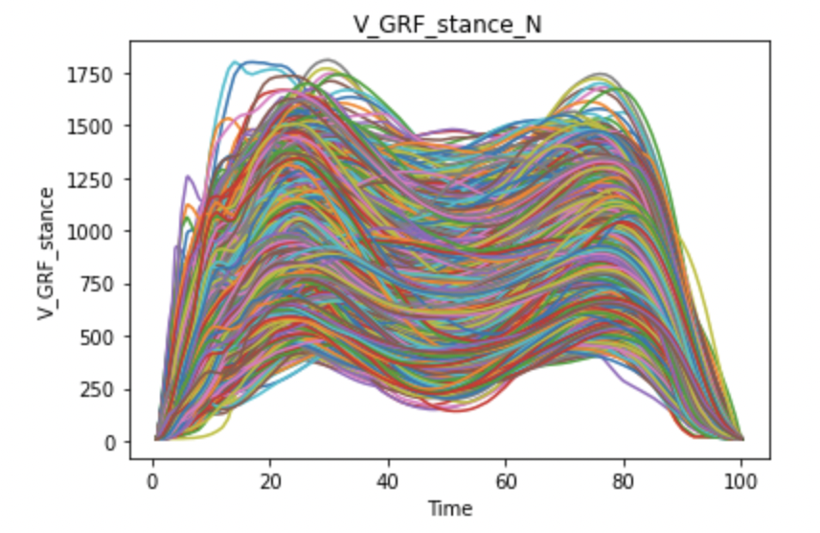
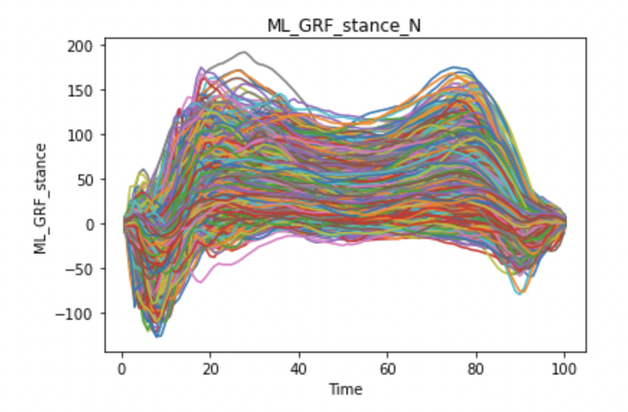
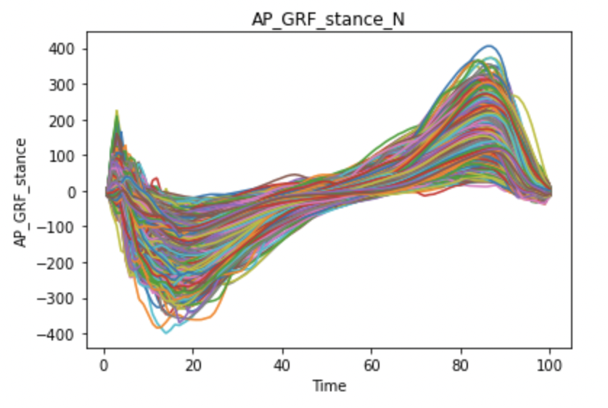
Visualizing the Data

Slide 6
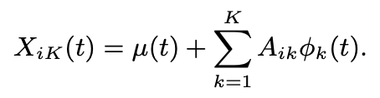
Functional Principal Component Analysis
Principal component analysis is a key dimension reduction tool for multivariate data
Finds principal vectors in the data that display the maximum variance in the direction of those principal vectors
Orthonormal basis
Python Package: scikit-fda

Slide 7
Methodology
Trained models based on different basis:
BSplines
Fourier
Trained models with a different number of components 2,4,6,8 and 10
The 10 component model showed the lowest errors and the highest variance explanation
Notes:
trade-off

Slide 8
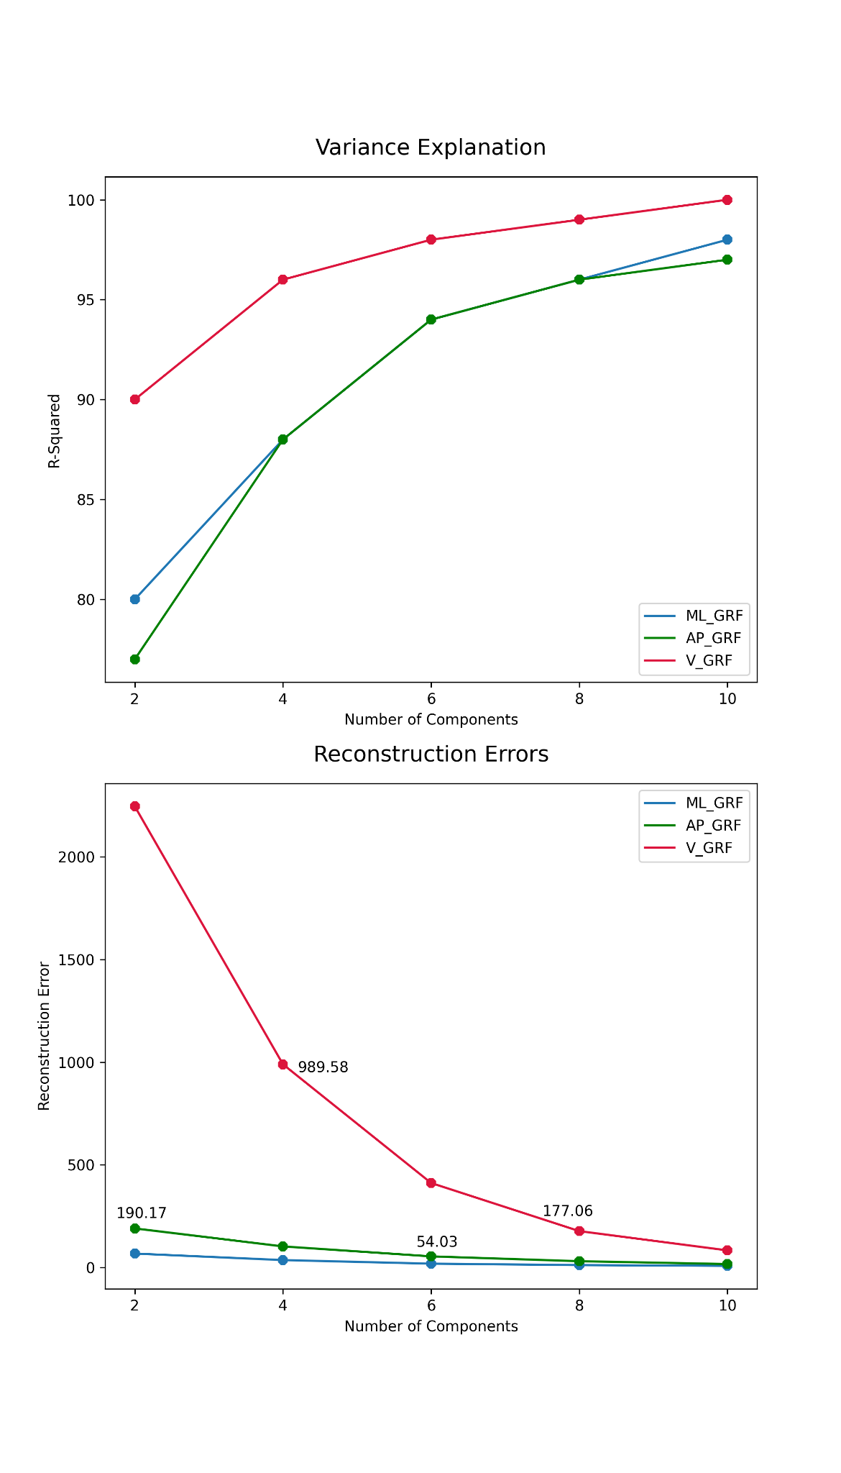
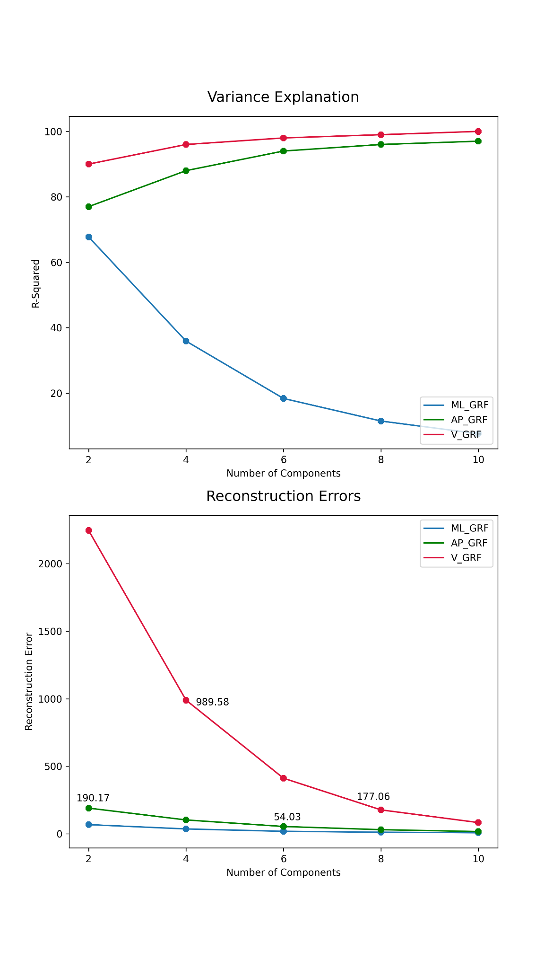
Model Performance

Slide 9
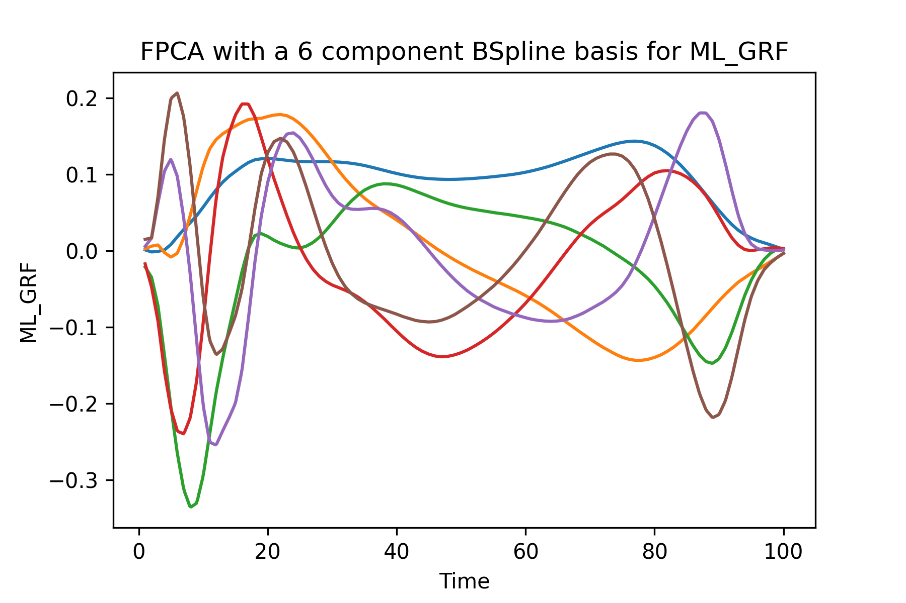
FPCA - ML_GRF
The model we chose:
6 Components
Explained 94% of the variance
Principal Component | Component Loading
1 | 70%
2 | 8%
3 | 6%
4 | 5%
5 | 4%
6 | 1%
Force Direction | MSE
Medial Lateral | 18.36

Slide 10
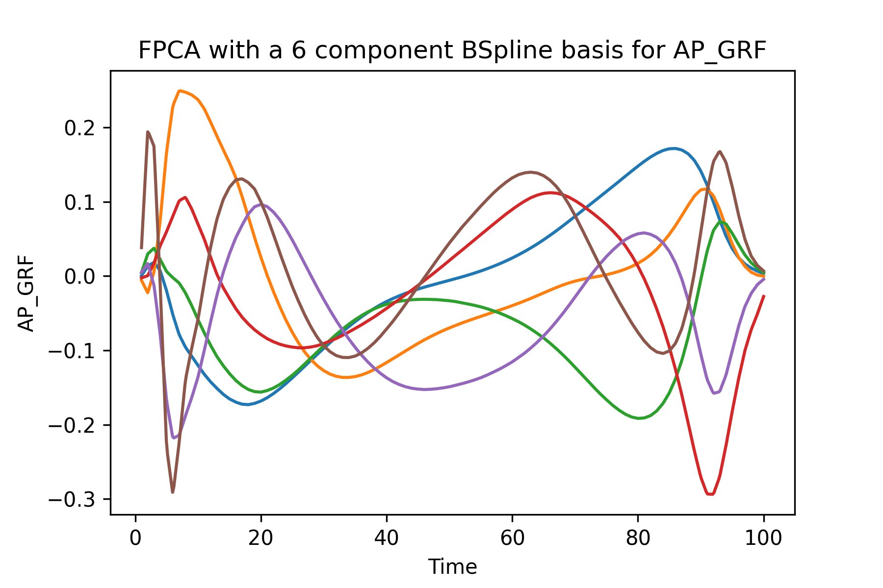
FPCA - AP_GRF
The model we chose:
6 Components
Explained 94% of the variance
Principal Component | Component Loading
1 | 69%
2 | 9%
3 | 6%
4 | 4%
5 | 4%
6 | 1%
Force Direction | MSE
Anterior Posterior | 54.03

Slide 11
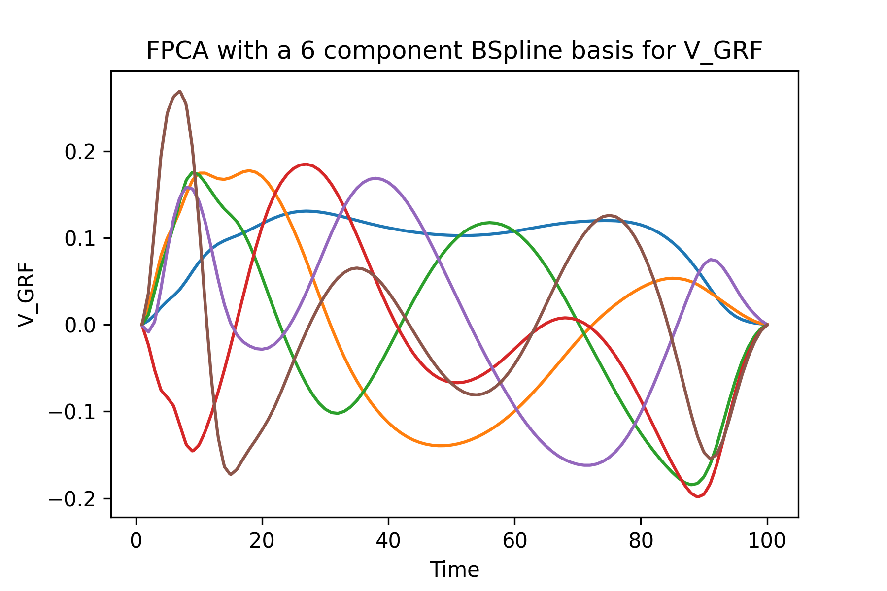
FPCA - V_GRF
The model we chose:
6 Components
Explained 98% of the variance
Principal Component | Component Loading
1 | 78%
2 | 13%
3 | 3%
4 | 2%
5 | 1%
6 | 0%
Force Direction | MSE
Vertical | 411.42

Slide 12
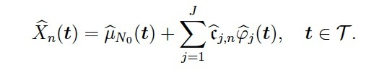
Multivariate Functional Principal Component Analysis
Multivariate form of FPCA
Addresses potential covariation between different elements
Input: combination of all the variables
Python Package: FDApy

Slide 13
Methodology
Tried two variations:
n individual components for each GRF direction (n = 2,4,6,8 and 10)
n combined components for all GRF directions (n = 3, 4, 5, 6, 7, 8, 9 and 10)
Trained models with different number of components
The 10 component model showed the lowest errors and the highest variance explanation

Slide 14
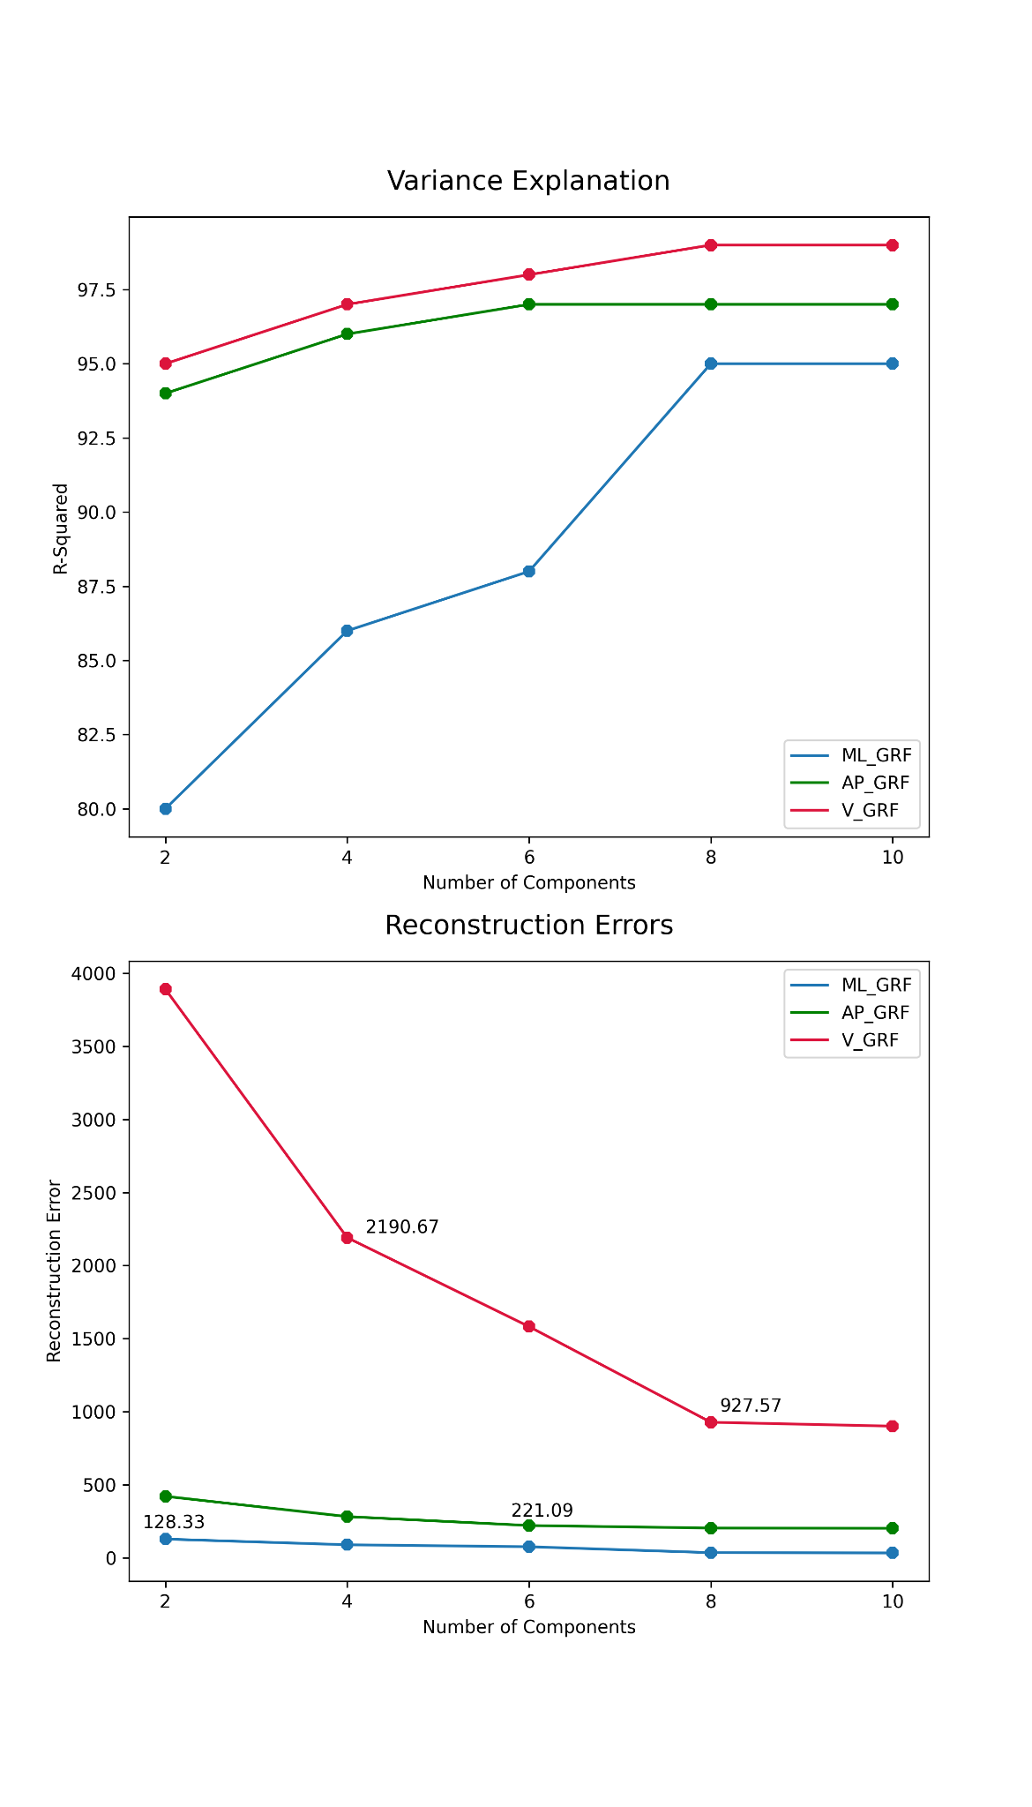
Model Performance

Slide 15
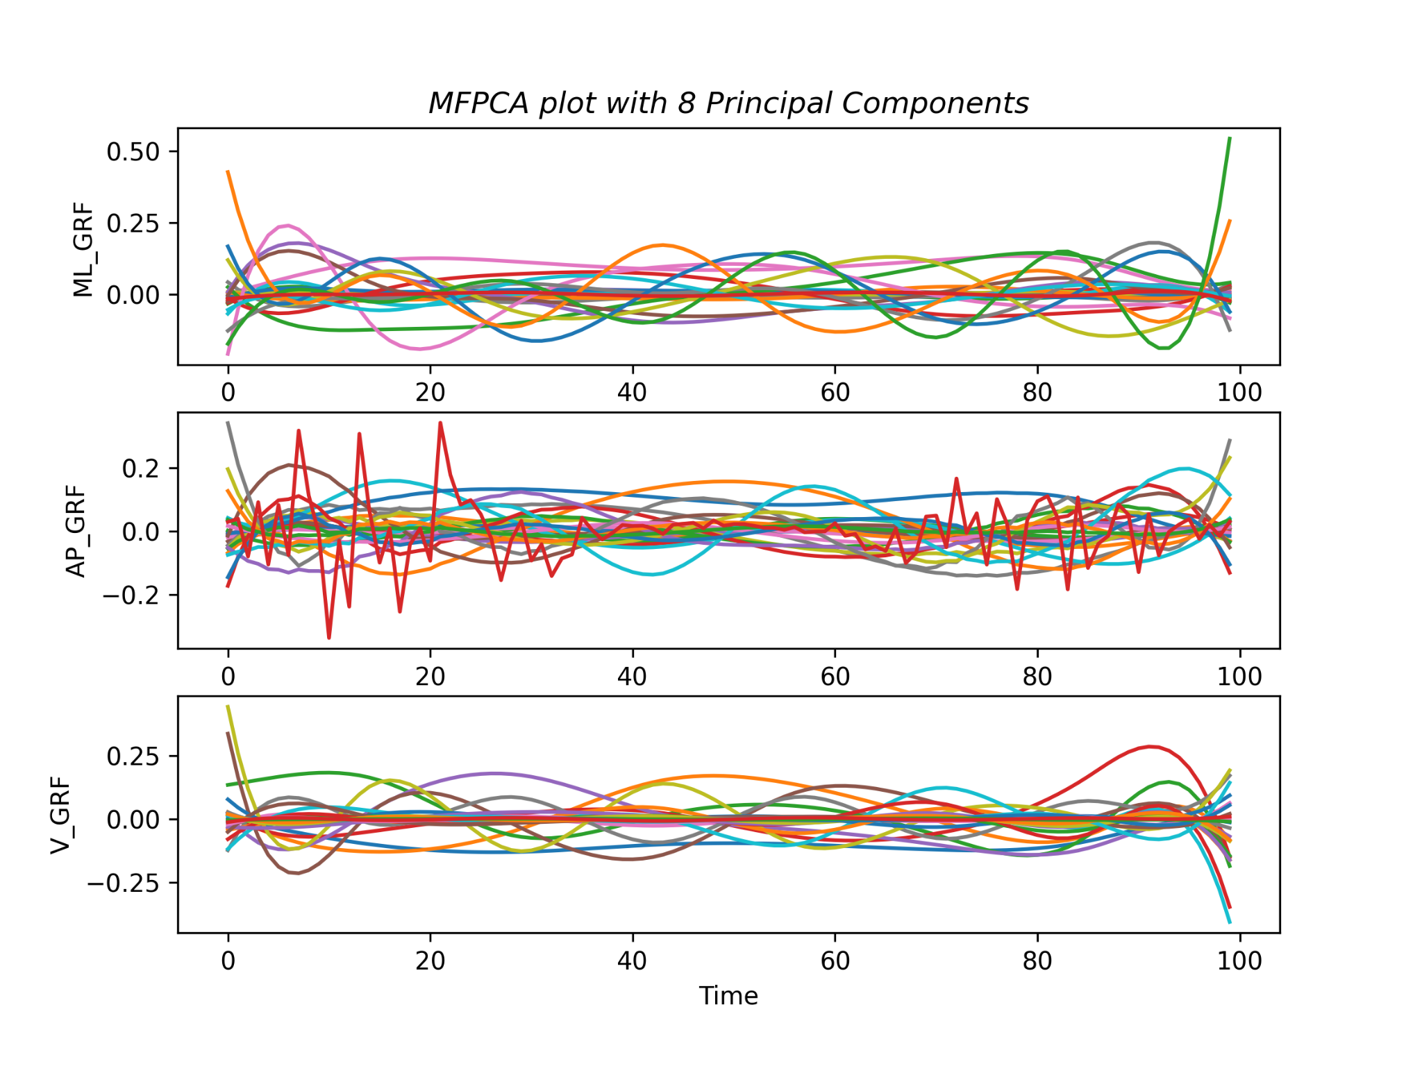
MFPCA With Individual PCs
Example model:
8 Components
GRF | MSE | Variance Explanation
ML | 35.13 | 95%
AP | 203.65 | 97%
V | 927.57 | 99%

Slide 16
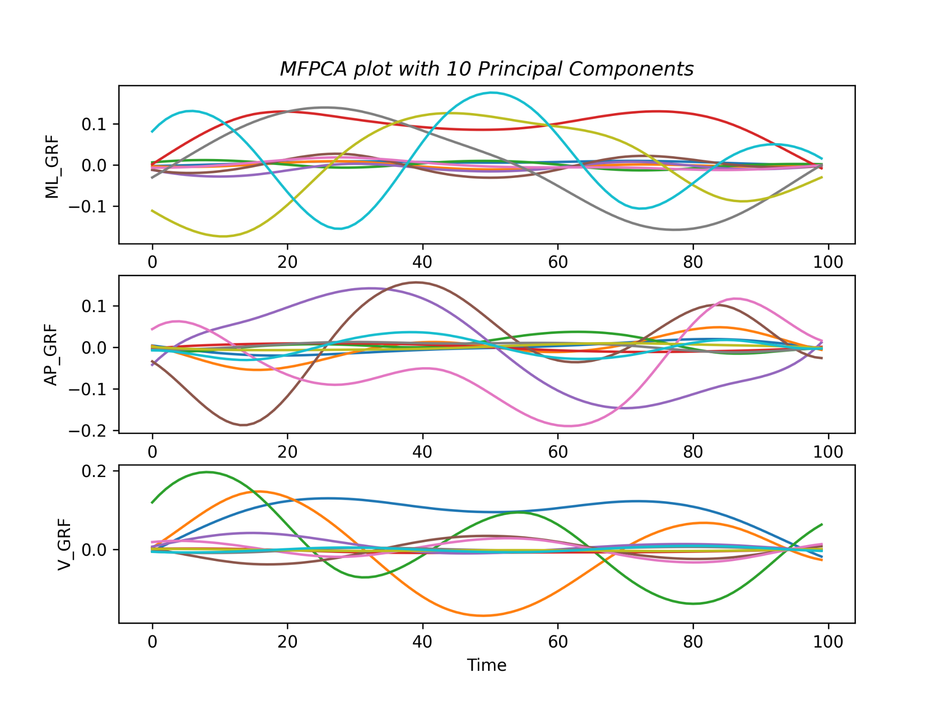
MFPCA With Combined PCs
Example model:
10 Components total
GRF | MSE | Variance Explanation
ML | 89.24 | 84%
AP | 339.77 | 95%
V | 2702.15 | 97%
Notes:
For Multivariate FPCA we calculated MSE for each variable

Slide 17
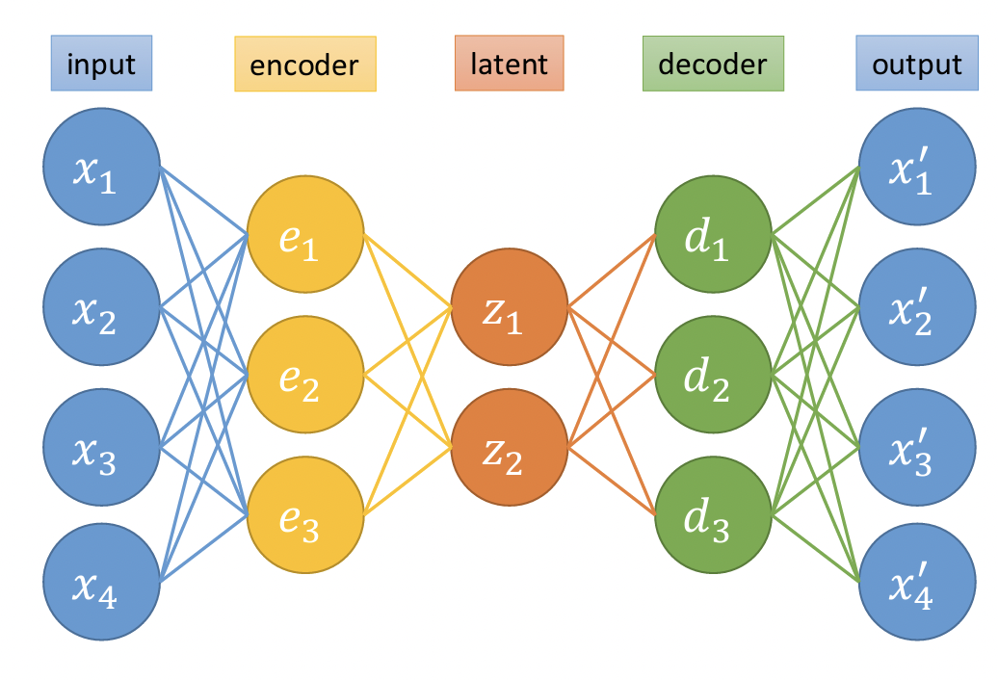
AutoEncoder
Notes:
An autoencoder is a neural network with this structure.
the data is the input…. The encoder and decoder are there for additional complexity.
The autoencoder is designed this way to get the latent variables.
this is called encoded data and is used as features.

Slide 18
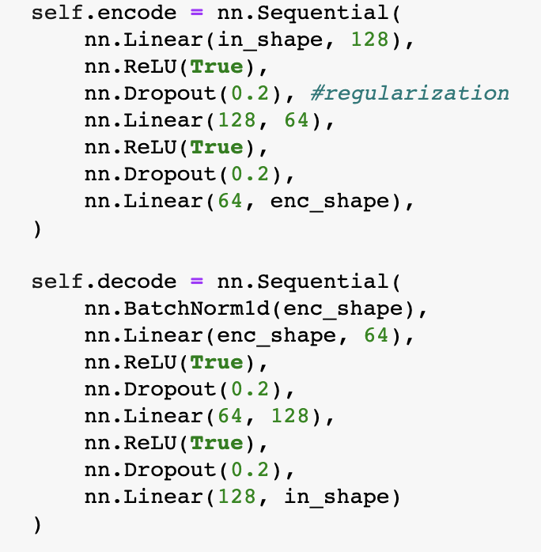
Methodology
Trained a model each for encoder sizes 2,4,6,8 and 10

Slide 19
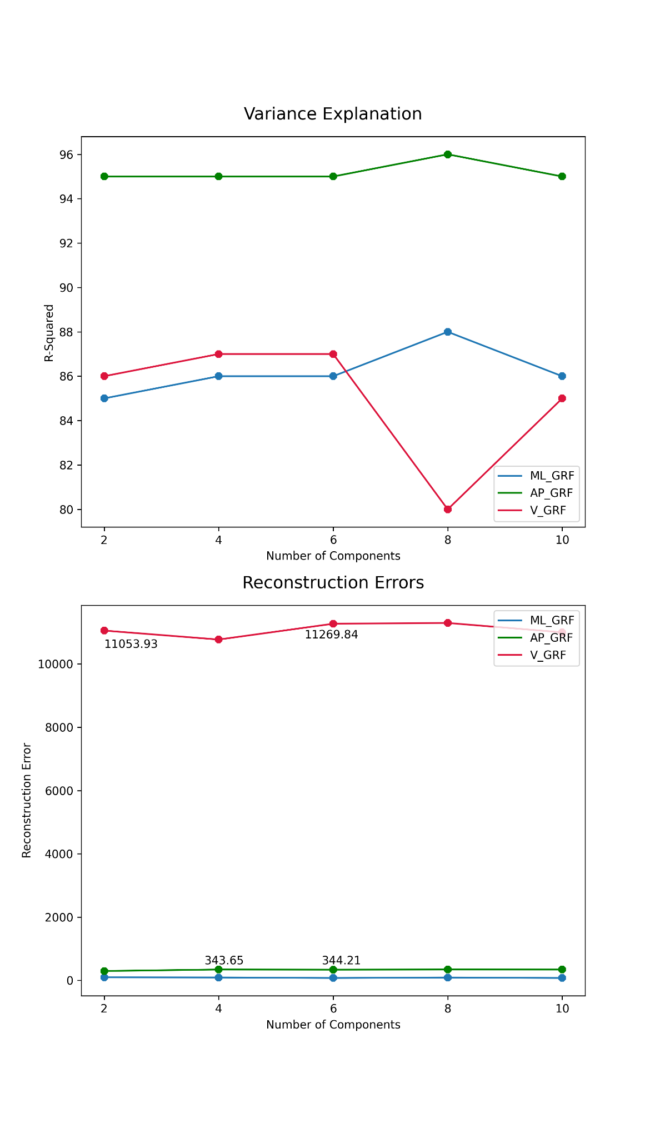
Model Performance

Slide 20
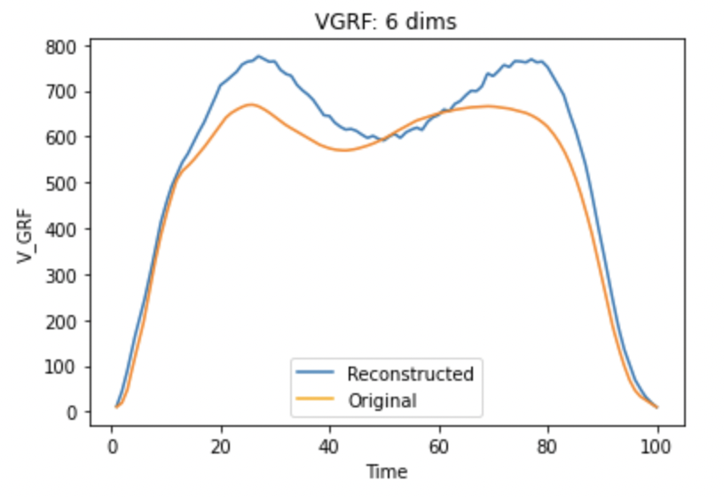
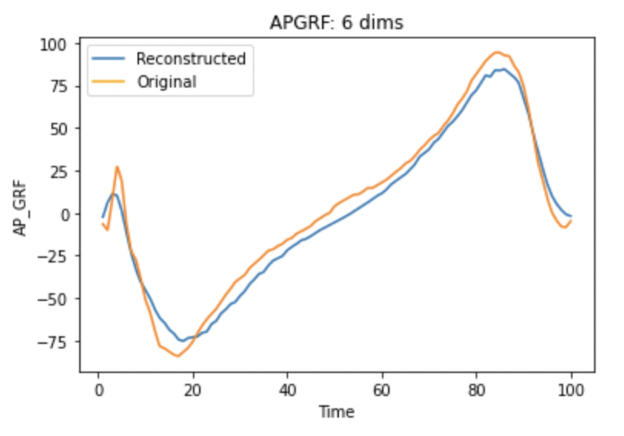
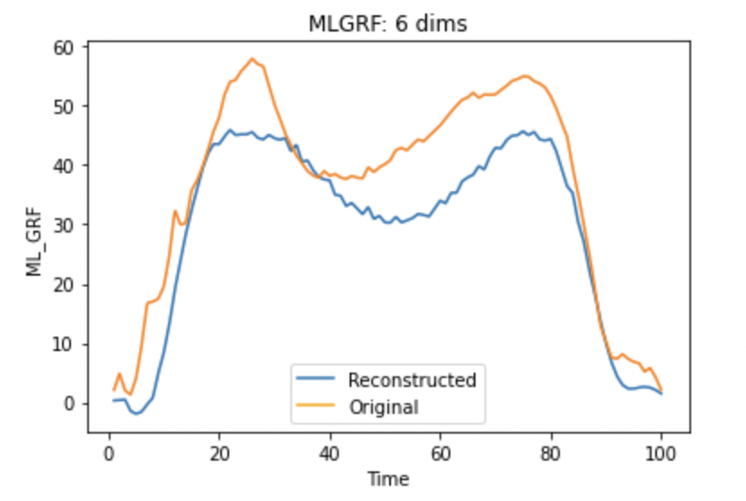
Reconstructed Plots

Slide 21
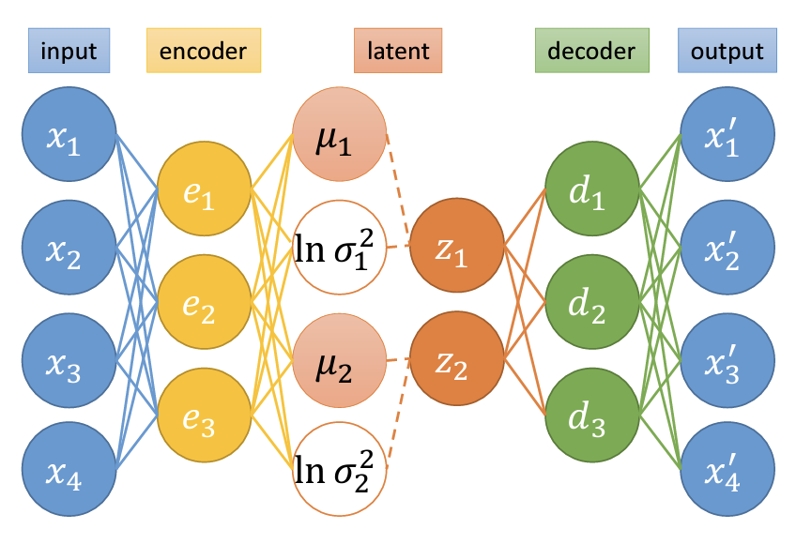
Variational AutoEncoder

Slide 22
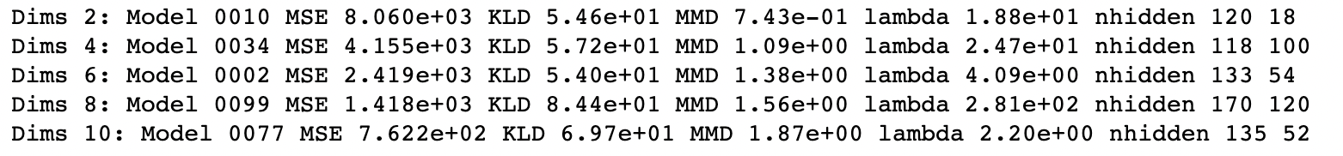
What we did
Trained 100 models each for encoder sizes 2,4,6,8 and 10
Each model had a randomly chosen lambda and hidden units
Selected the model with best loss value for each dimension
Best models for APGRF
Notes:
We wrote a training loop that trained 100 models each for different encoder dimension sizes. We then selected the best model for each dimension size. The training function had some aspects of hyperparameter optimization and each model had a different lambda and hidden layer units that were chosen randomly. The best APGRF models for each dimension size is shown here. For 4 dimensions, the VAE had 118 and 100 hidden units in 2 layers respectively.

Slide 23
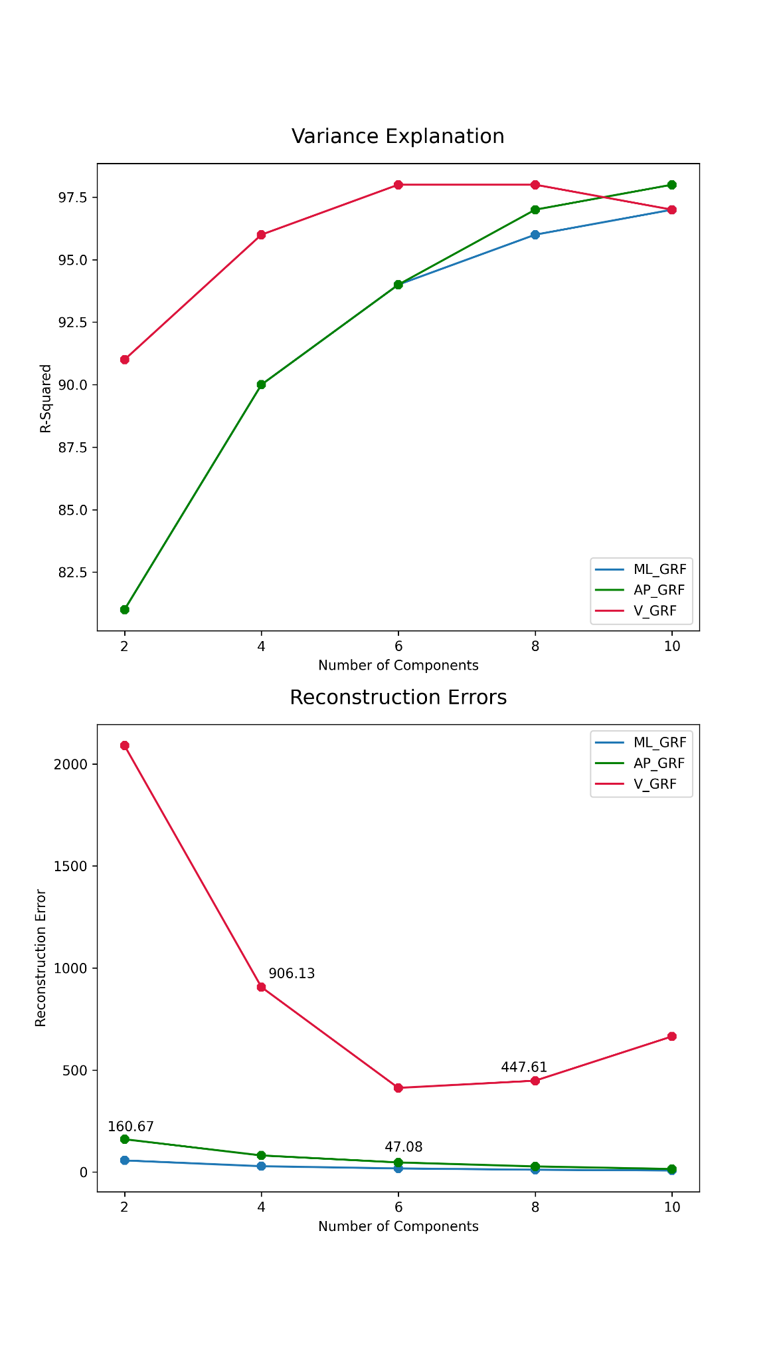
Model Performance

Slide 24
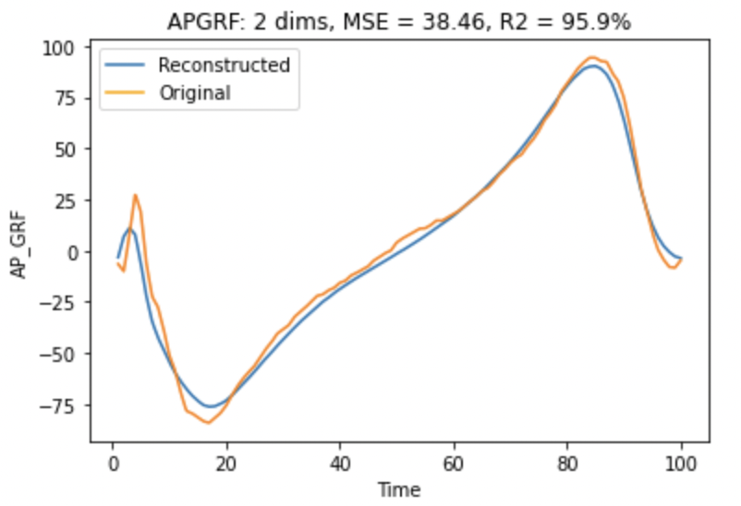
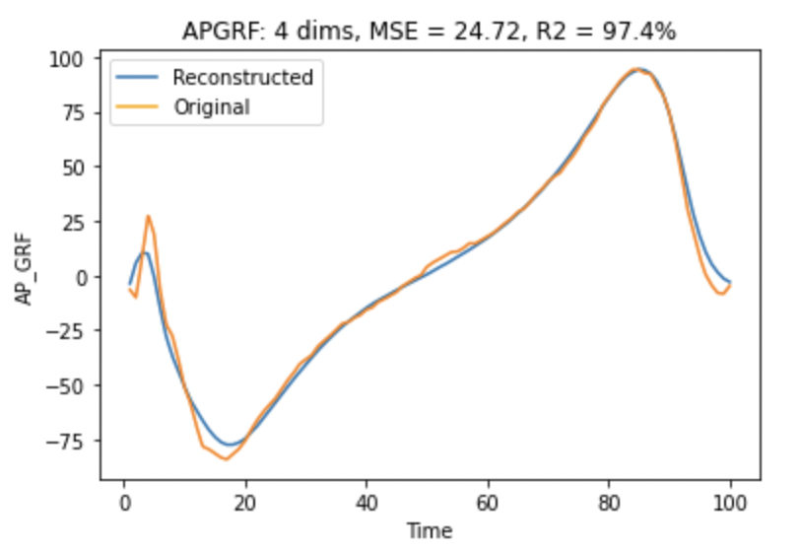
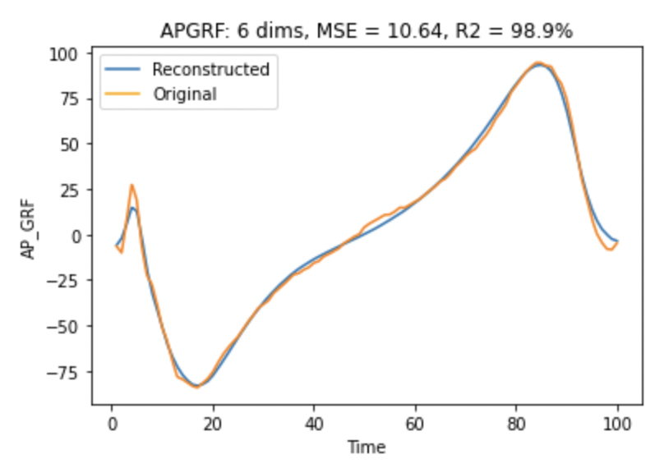
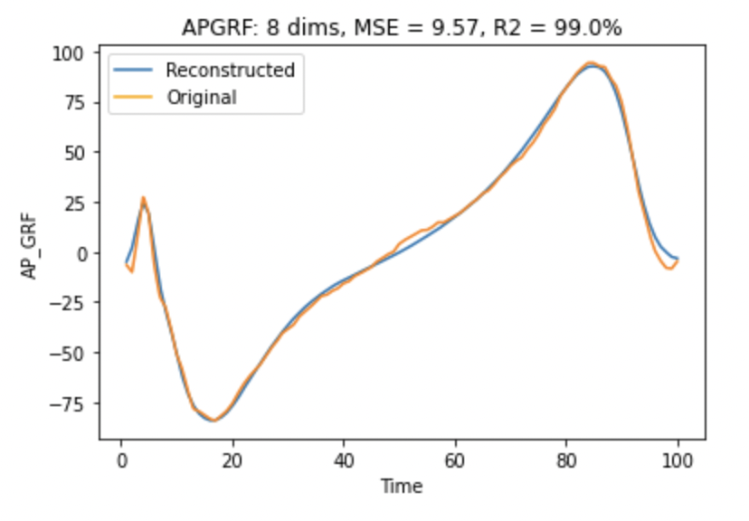
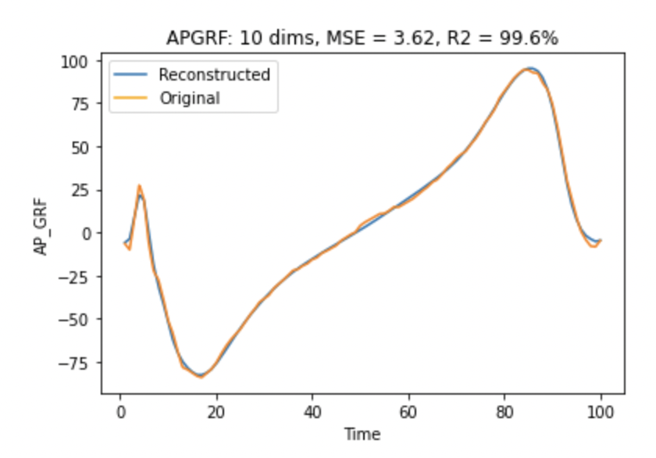
AP_GRF VAE Reconstruction Plots
Notes:
The reconstructions generally got better as dimensions increased

Slide 25
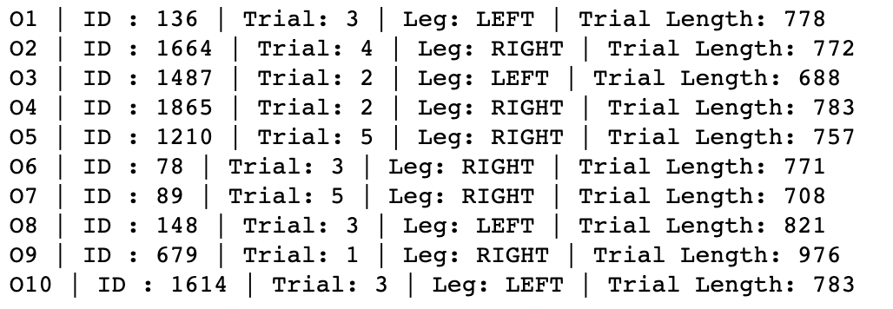
Outlier Detection
We ran a Local Outlier Factor algorithm on the VAE Latent Space
LOF is an unsupervised algorithm based on KNN clustering (K=20)

Slide 26
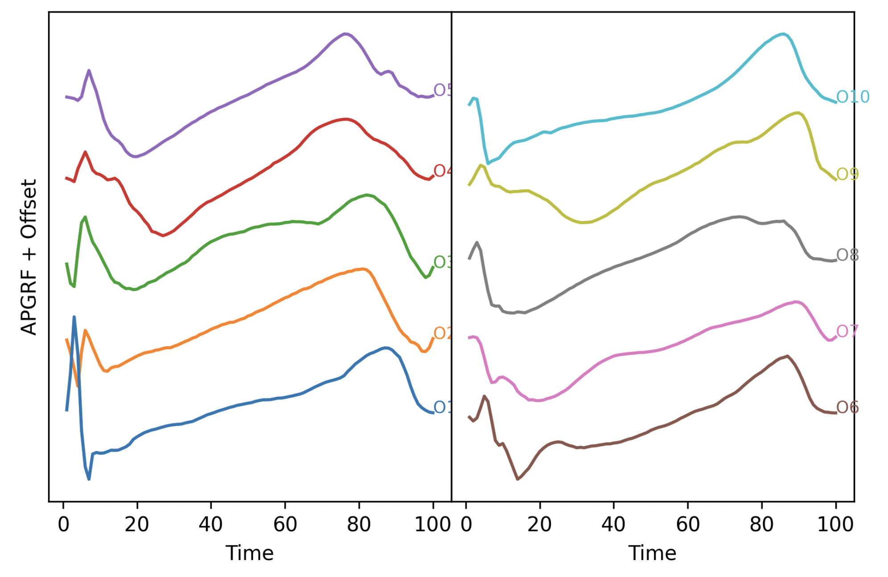
Are the outliers from problematic knees?

Slide 27
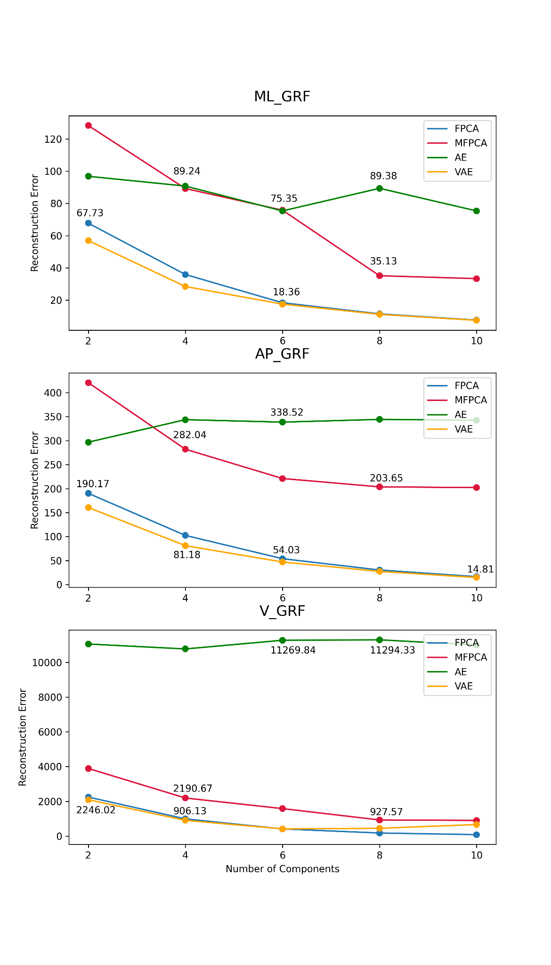
Comparison: Reconstruction Error

Slide 28
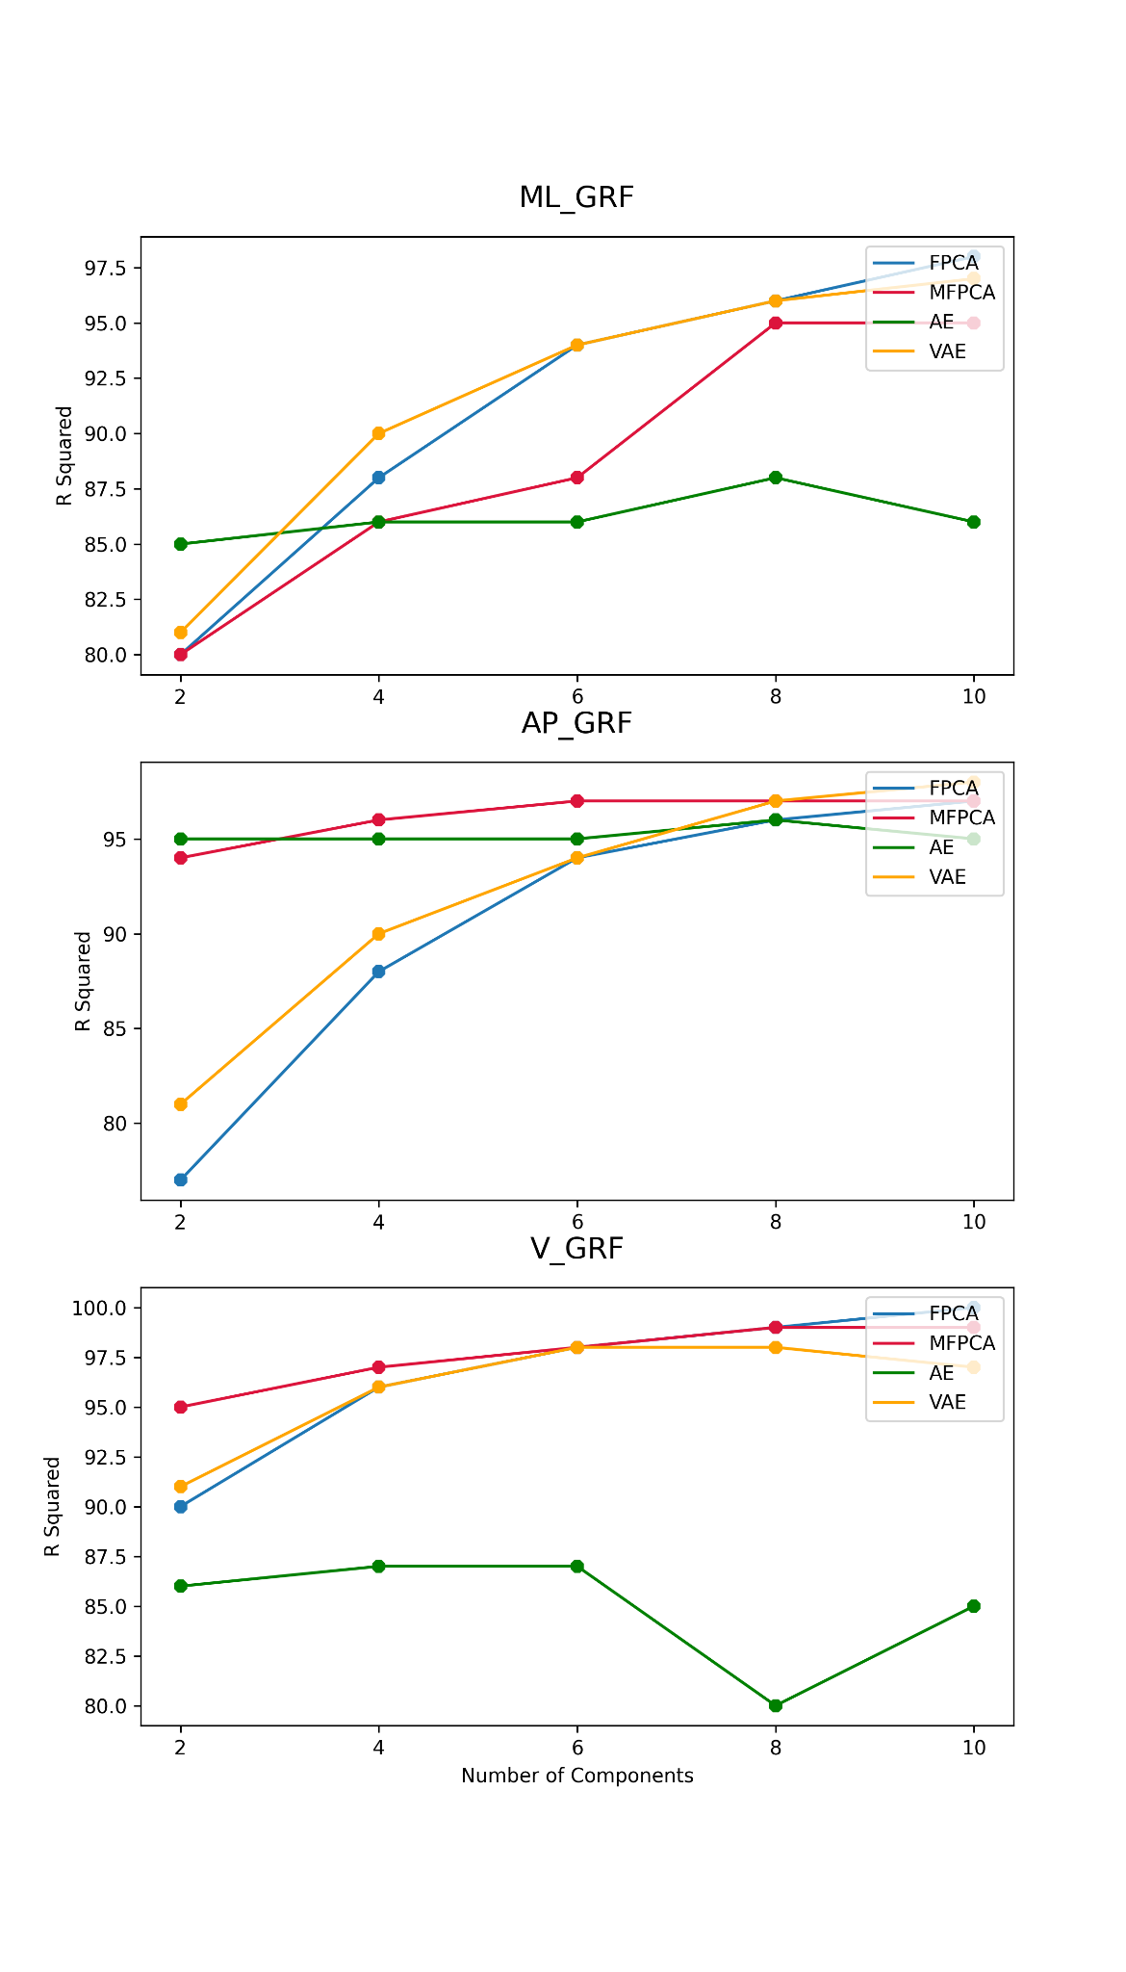
Comparison: Variance Explanation

Slide 29
Conclusion
FPCA is a simple linear model: Good results
MFPCA takes care of correlation between different directions
AE and VAE can be used to capture non-linearities
VAE performed the best
Next Steps
VAE with LSTM layers
Conditional VAE

Slide 30
The End

